Slide 1

Introduction to Scripting for image analysis Part 3

Slide 2
11 – Challenge time

Slide 3
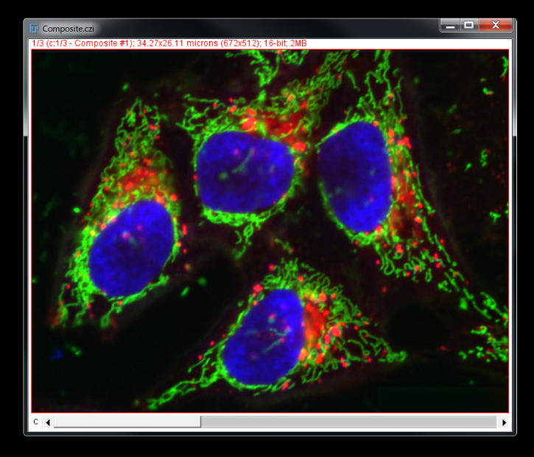
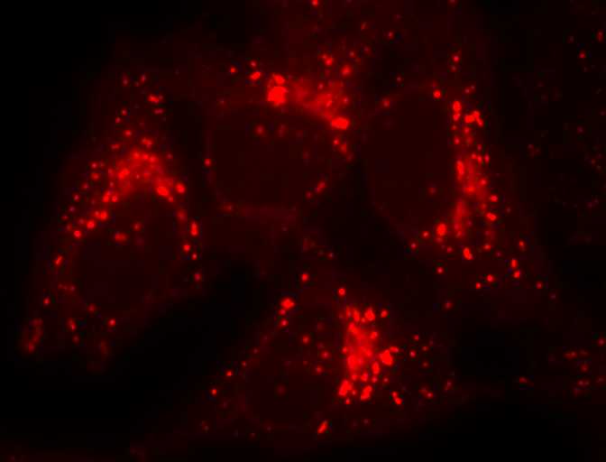
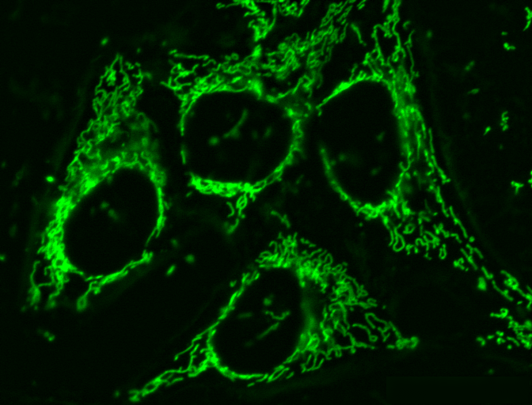
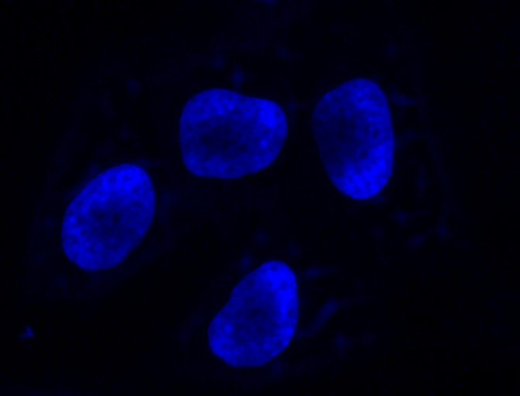
Challenge 1
Split all images into their constituent channels

Slide 4
we begin by defining a variable…
macro "Batch Split"{
format = ".tif";
...
}

Slide 5
macro "Batch Split"{
format = ".tif";
directory = getDirectory("Choose input files");
...
}

Slide 6
macro "Batch Split"{
format = ".tif";
directory = getDirectory("Choose input files");
print("Input: " + directory);
...
}

Slide 7
macro "Batch Split"{
format = ".tif";
directory = getDirectory("Choose input files");
print("Input: " + directory);
fileList = getFileList(directory);
...
}

Slide 8
macro "Batch Split"{
format = ".tif";
directory = getDirectory("Choose input files");
print("Input: " + directory);
fileList = getFileList(directory);
print(fileList.length + " files.");
...
}

Slide 9
macro "Batch Split"{
format = ".tif";
directory = getDirectory("Choose input files");
print("Input: " + directory);
fileList = getFileList(directory);
print(fileList.length + " files.");
outputDirectory = getDirectory("Choose output directory");
print("Output: " + outputDirectory);
setBatchMode(true);
...
}

Slide 10
The Set Batch Mode function
setBatchMode(arg)
Controls whether images are visible or hidden during macro execution.
Why is this useful?
Interacting with a window mid-macro can cause errors
Batch mode macros run up to 20x faster.
Load pixel data
Create canvas to display image
Create window to display canvas
Display window, monitor user input

Slide 11
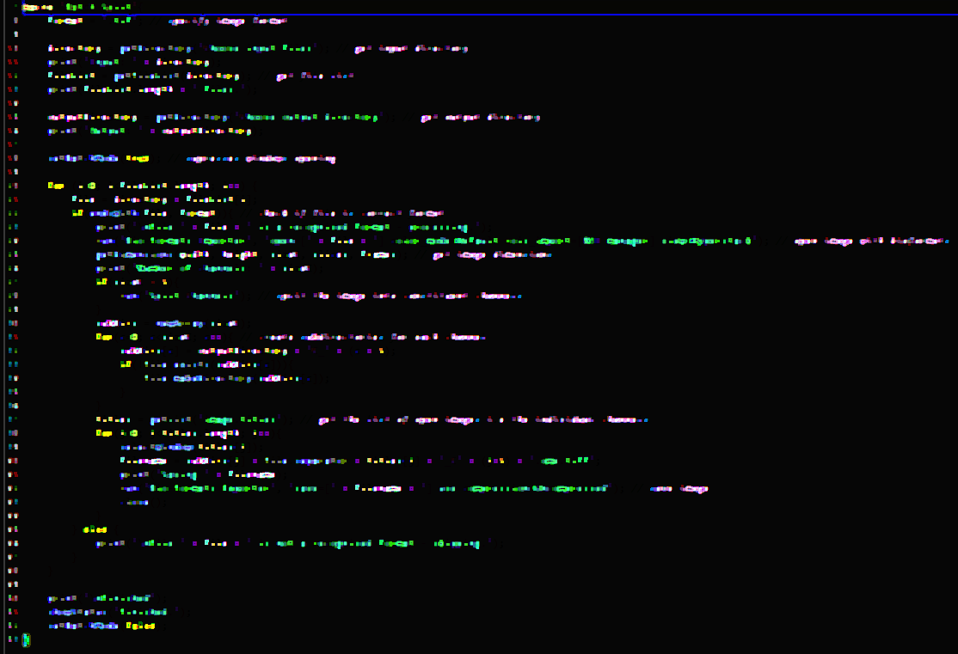
DEMO 7 – Batch Mode
Open Snippets/07_Batch_Mode.ijm
width

Slide 12
macro "Batch Split"{
format = ".tif";
directory = getDirectory("Choose input files");
print("Input: " + directory);
fileList = getFileList(directory)
print(fileList.length + " files.");
outputDirectory = getDirectory("Choose output directory");
print("Output: " + outputDirectory);
setBatchMode(true);
...
setBatchMode(false);
}
Now we want to do something useful with the image files

Slide 13
macro "Batch Split"{
format = ".tif";
directory = getDirectory("Choose input files");
print("Input: " + directory);
fileList = getFileList(directory)
print(fileList.length + " files.");
outputDirectory = getDirectory("Choose output directory");
print("Output: " + outputDirectory);
setBatchMode(true);
for (i = 0; i < fileList.length; i++) {
...
}
setBatchMode(false);
}

Slide 14
macro "Batch Split"{
format = ".tif";
directory = getDirectory("Choose input files");
print("Input: " + directory);
fileList = getFileList(directory)
print(fileList.length + " files.");
outputDirectory = getDirectory("Choose output directory");
print("Output: " + outputDirectory);
setBatchMode(true);
for (i = 0; i < fileList.length; i++) {
file = directory + fileList[i];
...
}
setBatchMode(false);
}
We could now, for example, list all the file names

Slide 15
macro "Batch Split"{
format = ".tif";
directory = getDirectory("Choose input files");
print("Input: " + directory);
fileList = getFileList(directory)
print(fileList.length + " files.");
outputDirectory = getDirectory("Choose output directory");
print("Output: " + outputDirectory);
setBatchMode(true);
for (i = 0; i < fileList.length; i++) {
file = directory + fileList[i];
print("Current File: " + file);
...
}
setBatchMode(false);
}
However, it would be useful to check what the file is first…

Slide 16
macro "Batch Split"{
format = ".tif";
directory = getDirectory("Choose input files");
print("Input: " + directory);
fileList = getFileList(directory)
print(fileList.length + " files.");
outputDirectory = getDirectory("Choose output directory");
print("Output: " + outputDirectory);
setBatchMode(true);
for (i = 0; i < fileList.length; i++) {
file = directory + fileList[i];
if(endsWith(file, format)){
...
}
...
}
setBatchMode(false);
}

Slide 17
macro "Batch Split"{
format = ".tif";
directory = getDirectory("Choose input files");
print("Input: " + directory);
fileList = getFileList(directory)
print(fileList.length + " files.");
outputDirectory = getDirectory("Choose output directory");
print("Output: " + outputDirectory);
setBatchMode(true);
for (i = 0; i < fileList.length; i++) {
file = directory + fileList[i];
if(endsWith(file, format)){
...
}
...
}
setBatchMode(false);
}

Slide 18
macro "Batch Split"{
format = ".tif";
directory = getDirectory("Choose input files");
print("Input: " + directory);
fileList = getFileList(directory)
print(fileList.length + " files.");
outputDirectory = getDirectory("Choose output directory");
print("Output: " + outputDirectory);
setBatchMode(true);
for (i = 0; i < fileList.length; i++) {
file = directory + fileList[i];
if(endsWith(file, format)){
print("\nFile " + file + " is a recognised format - processing.");
}
...
}
setBatchMode(false);
}

Slide 19
macro "Batch Split"{
format = ".tif";
directory = getDirectory("Choose input files");
print("Input: " + directory);
fileList = getFileList(directory)
print(fileList.length + " files.");
outputDirectory = getDirectory("Choose output directory");
print("Output: " + outputDirectory);
setBatchMode(true);
for (i = 0; i < fileList.length; i++) {
file = directory + fileList[i];
if(endsWith(file, format)){
print("\nFile " + file + " is a recognised format - processing.");
} else {
print("\nFile " + file + " is not a recognised format - skipping.");
}
}
setBatchMode(false);
}
I’m running out of space, so I’m just going to focus on the content of the ‘for’ loop now…
So let’s do something with these files…

Slide 20
Introducing The Run command
for (i = 0; i < fileList.length; i++) {
file = directory + fileList[i];
if(endsWith(file, format)){
print("\nFile " + file + " is a recognised format - processing.");
run("Bio-Formats Importer", "open=[" + file + "] color_mode=Default rois_import=[ROI manager] view=Hyperstack");
} else {
print("\nFile " + file + " is not a recognised format - skipping.");
}
}

Slide 21
Introducing The Run command
for (i = 0; i < fileList.length; i++) {
file = directory + fileList[i];
if(endsWith(file, format)){
print("\nFile " + file + " is a recognised format - processing.");
run("Bio-Formats Importer", "open=[" + file + "] color_mode=Default rois_import=[ROI manager] view=Hyperstack");
} else {
print("\nFile " + file + " is not a recognised format - skipping.");
}
}

Slide 22
8 – The RUN Command

Slide 23
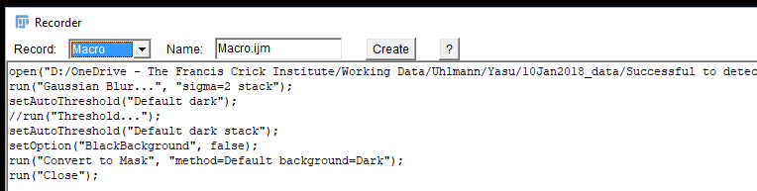
The Run command
run("command", "options")
Executes an ImageJ menu command.
Options argument contains values automatically entered into dialog boxes.
Provides access to most menu commands

Slide 24
Run command OPTIONS
run("command", "options");
run("Set Measurements...", "area shape display redirect=None decimal=3");
…and each MUST be separated by a space.
Each of these represents something selected in the dialog box…

Slide 25
But what if I need to specify an option that contains spaces?
run("Bio-Formats Importer", "open=[D:/OneDrive - The Francis Crick Institute/Training/Scripting Workshop/Scripting Workshop Images/ScriptingWorkshopImages_2_MMStack_Pos0.ome.tif]");
run("Bio-Formats Importer", "open=D:/OneDrive - The Francis Crick Institute/Training/Scripting Workshop/Scripting Workshop Images/ScriptingWorkshopImages_2_MMStack_Pos0.ome.tif");
Square brackets tell FIJI to ignore spaces between them

Slide 26
DEMO 10 – The Run Statement
Open Snippets/10_Run_Statement.ijm
width

Slide 27
Problem 4 – The RUN Statement
Open Problems/4_The_Run_Statement.ijm
width

Slide 28
for (i = 0; i < fileList.length; i++) {
file = directory + fileList[i];
if(endsWith(file, format)){
print("\nFile " + file + " is a recognised format - processing.");
run("Bio-Formats Importer", "open=[" + file + "] color_mode=Default rois_import=[ROI manager] view=Hyperstack");
getDimensions(width, height, sizeC, slices, frames);
} else {
print("\nFile " + file + " is not a recognised format - skipping.");
}
}
getDimensions(width, height, channels, slices, frames)
Returns the dimensions of the current image.

Slide 29
for (i = 0; i < fileList.length; i++) {
file = directory + fileList[i];
if(endsWith(file, format)){
print("\nFile " + file + " is a recognised format - processing.");
run("Bio-Formats Importer", "open=[" + file + "] color_mode=Default rois_import=[ROI manager] view=Hyperstack");
getDimensions(width, height, sizeC, slices, frames);
print("Number of channels: " + sizeC);
} else {
print("\nFile " + file + " is not a recognised format - skipping.");
}
}

Slide 30
for (i = 0; i < fileList.length; i++) {
file = directory + fileList[i];
if(endsWith(file, format)){
print("\nFile " + file + " is a recognised format - processing.");
run("Bio-Formats Importer", "open=[" + file + "] color_mode=Default rois_import=[ROI manager] view=Hyperstack");
getDimensions(width, height, sizeC, slices, frames);
print("Number of channels: " + sizeC);
if(sizeC > 1){
run("Split Channels");
}
} else {
print("\nFile " + file + " is not a recognised format - skipping.");
}
}
Why don’t we just run the split channels command without the IF statement?
Split Channels will return an error if there are less than two channels.
Another good example of error checking
Always assume the user is an idiot!

Slide 31
for (i = 0; i < fileList.length; i++) {
file = directory + fileList[i];
if(endsWith(file, format)){
print("\nFile " + file + " is a recognised format - processing.");
run("Bio-Formats Importer", "open=[" + file + "] color_mode=Default rois_import=[ROI manager] view=Hyperstack");
getDimensions(width, height, sizeC, slices, frames);
print("Number of channels: " + sizeC);
if(sizeC > 1){
run("Split Channels");
}
subDirs = newArray(sizeC);
} else {
print("\nFile " + file + " is not a recognised format - skipping.");
}
}
Create a list that will contain sub-directories

Slide 32
for (i = 0; i < fileList.length; i++) {
file = directory + fileList[i];
if(endsWith(file, format)){
print("\nFile " + file + " is a recognised format - processing.");
run("Bio-Formats Importer", "open=[" + file + "] color_mode=Default rois_import=[ROI manager] view=Hyperstack");
getDimensions(width, height, sizeC, slices, frames);
print("Number of channels: " + sizeC);
if(sizeC > 1){
run("Split Channels");
}
subDirs = newArray(sizeC);
for(c = 0; c < sizeC; c++){
}
} else {
print("\nFile " + file + " is not a recognised format - skipping.");
}
}
Iterate over each of the channels

Slide 33
for (i = 0; i < fileList.length; i++) {
file = directory + fileList[i];
if(endsWith(file, format)){
print("\nFile " + file + " is a recognised format - processing.");
run("Bio-Formats Importer", "open=[" + file + "] color_mode=Default rois_import=[ROI manager] view=Hyperstack");
getDimensions(width, height, sizeC, slices, frames);
print("Number of channels: " + sizeC);
if(sizeC > 1){
run("Split Channels");
}
subDirs = newArray(sizeC);
for(c = 0; c < sizeC; c++){
subDirs[c] = outputDirectory + "C_" + (c+ 1);
}
} else {
print("\nFile " + file + " is not a recognised format - skipping.");
}
}
Construct sub-directory names based on output directory and channel number
Still need to create directories on file system

Slide 34
for (i = 0; i < fileList.length; i++) {
file = directory + fileList[i];
if(endsWith(file, format)){
print("\nFile " + file + " is a recognised format - processing.");
run("Bio-Formats Importer", "open=[" + file + "] color_mode=Default rois_import=[ROI manager] view=Hyperstack");
getDimensions(width, height, sizeC, slices, frames);
print("Number of channels: " + sizeC);
if(sizeC > 1){
run("Split Channels");
}
subDirs = newArray(sizeC);
for(c = 0; c < sizeC; c++){
subDirs[c] = outputDirectory + "C_" + (c + 1);
if(!File.exists(subDirs[c])){
}
}
}
}
Boolean complement operator
!false = true;
!true = false;
Check if directory exists

Slide 35
for (i = 0; i < fileList.length; i++) {
file = directory + fileList[i];
if(endsWith(file, format)){
print("\nFile " + file + " is a recognised format - processing.");
run("Bio-Formats Importer", "open=[" + file + "] color_mode=Default rois_import=[ROI manager] view=Hyperstack");
getDimensions(width, height, sizeC, slices, frames);
print("Number of channels: " + sizeC);
if(sizeC > 1){
run("Split Channels");
}
subDirs = newArray(sizeC);
for(c = 0; c < sizeC; c++){
subDirs[c] = outputDirectory + "C_" + (c + 1);
if(!File.exists(subDirs[c])){ File.makeDirectory(subDirs[c]);
}
}
}
}
Create the directories if they do not already exist

Slide 36
8 – Working with Image Windows

Slide 37
Let’s do something with images!
We have a script that will open images and create directories
Now we need to do something with the images
Q: How do we direct FIJI to a particular image?
A: We need to know the image names
getList("image.titles")
Returns a list (array) of image window titles.
getList("window.titles")
Returns a list (array) of non-image window titles.

Slide 38
Before doing anything with an image, we need to tell FIJI which image we want to work on…
selectWindow("name")
Activates the window with the title "name".

Slide 39
Close Function
close()
Closes the active image.
close(pattern)
Closes windows whose title matches 'pattern'.
For example, close("Histo*") would close all histogram windows.
Use close("*") to close all image windows.

Slide 40
for (i = 0; i < fileList.length; i++) {
file = directory + fileList[i];
if(endsWith(file, format)){
print("\nFile " + file + " is a recognised format - processing.");
run("Bio-Formats Importer", "open=[" + file + "] color_mode=Default rois_import=[ROI manager] view=Hyperstack");
getDimensions(width, height, sizeC, slices, frames);
print("Number of channels: " + sizeC);
if(sizeC > 1){
run("Split Channels");
}
subDirs = newArray(sizeC);
for(c = 0; c < sizeC; c++){
subDirs[c] = outputDirectory + "C_" + (c + 1);
if(!File.exists(subDirs[c])){ File.makeDirectory(subDirs[c]);
}
}
titles = getList("image.titles");
}
}
Get the list of open images…

Slide 41
for (i = 0; i < fileList.length; i++) {
file = directory + fileList[i];
if(endsWith(file, format)){
print("\nFile " + file + " is a recognised format - processing.");
run("Bio-Formats Importer", "open=[" + file + "] color_mode=Default rois_import=[ROI manager] view=Hyperstack");
getDimensions(width, height, sizeC, slices, frames);
print("Number of channels: " + sizeC);
if(sizeC > 1){
run("Split Channels");
}
subDirs = newArray(sizeC);
for(c = 0; c < sizeC; c++){
subDirs[c] = outputDirectory + "C_" + (c + 1);
if(!File.exists(subDirs[c])){ File.makeDirectory(subDirs[c]);
}
}
titles = getList("image.titles");
for(j = 0; j < titles.length; j++){
}
}
}
…and iterate over the list.

Slide 42
for (i = 0; i < fileList.length; i++) {
file = directory + fileList[i];
if(endsWith(file, format)){
print("\nFile " + file + " is a recognised format - processing.");
run("Bio-Formats Importer", "open=[" + file + "] color_mode=Default rois_import=[ROI manager] view=Hyperstack");
getDimensions(width, height, sizeC, slices, frames);
print("Number of channels: " + sizeC);
if(sizeC > 1){
run("Split Channels");
}
subDirs = newArray(sizeC);
for(c = 0; c < sizeC; c++){
subDirs[c] = outputDirectory + "C_" + (c + 1);
if(!File.exists(subDirs[c])){ File.makeDirectory(subDirs[c]);
}
}
titles = getList("image.titles");
for(j = 0; j < titles.length; j++){
selectWindow(titles[j]);
}
}
}
We need to create a filename for the image before we save it

Slide 43
for (i = 0; i < fileList.length; i++) {
file = directory + fileList[i];
if(endsWith(file, format)){
print("\nFile " + file + " is a recognised format - processing.");
run("Bio-Formats Importer", "open=[" + file + "] color_mode=Default rois_import=[ROI manager] view=Hyperstack");
getDimensions(width, height, sizeC, slices, frames);
print("Number of channels: " + sizeC);
if(sizeC > 1){
run("Split Channels");
}
subDirs = newArray(sizeC);
for(c = 0; c < sizeC; c++){
subDirs[c] = outputDirectory + "C_" + (c + 1);
if(!File.exists(subDirs[c])){ File.makeDirectory(subDirs[c]);
}
}
titles = getList("image.titles");
for(j = 0; j < titles.length; j++){
selectWindow(titles[j]);
filename = subDirs[j] + File.separator + titles[j] + "_C" + (j + 1) + ".ome.tiff";
}
}
}
Now we just need to save the image…

Slide 44
for (i = 0; i < fileList.length; i++) {
file = directory + fileList[i];
if(endsWith(file, format)){
print("\nFile " + file + " is a recognised format - processing.");
run("Bio-Formats Importer", "open=[" + file + "] color_mode=Default rois_import=[ROI manager] view=Hyperstack");
getDimensions(width, height, sizeC, slices, frames);
print("Number of channels: " + sizeC);
if(sizeC > 1){
run("Split Channels");
}
subDirs = newArray(sizeC);
for(c = 0; c < sizeC; c++){
subDirs[c] = outputDirectory + "C_" + (c + 1);
if(!File.exists(subDirs[c])){ File.makeDirectory(subDirs[c]);
}
}
titles = getList("image.titles");
for(j = 0; j < titles.length; j++){
selectWindow(titles[j]);
filename = subDirs[j] + File.separator + titles[j] + "_C" + (j + 1) + ".ome.tiff";
print("Saving " + filename);
run("Bio-Formats Exporter",
"save=[" + filename + "]
use compression=Uncompressed");
}
}
}
…and close it

Slide 45
for (i = 0; i < fileList.length; i++) {
file = directory + fileList[i];
if(endsWith(file, format)){
print("\nFile " + file + " is a recognised format - processing.");
run("Bio-Formats Importer", "open=[" + file + "] color_mode=Default rois_import=[ROI manager] view=Hyperstack");
getDimensions(width, height, sizeC, slices, frames);
print("Number of channels: " + sizeC);
if(sizeC > 1){
run("Split Channels");
}
subDirs = newArray(sizeC);
for(c = 0; c < sizeC; c++){
subDirs[c] = outputDirectory + "C_" + (c + 1);
if(!File.exists(subDirs[c])){ File.makeDirectory(subDirs[c]);
}
}
titles = getList("image.titles");
for(j = 0; j < titles.length; j++){
selectWindow(titles[j]);
filename = subDirs[j] + File.separator + titles[j] + "_C" + (j + 1) + ".ome.tiff";
print("Saving " + filename);
run("Bio-Formats Exporter",
"save=[" + filename + "]
use compression=Uncompressed");
close();
}
}
}

Slide 46
// Dave Barry, Francis Crick Institute
// 2018.01.17 // david.barry@crick.ac.uk
// Converts all files in a directory to TIFF - there will be one TIFF file per channel per input file.
macro "Batch Split"{
format = ".tif";
directory = getDirectory("Choose input files");
print("Input: " + directory);
fileList = getFileList(directory);
print(fileList.length + " files.");
outputDirectory = getDirectory("Choose output directory");
print("Output: " + outputDirectory);
setBatchMode(true);
for (i=0; i<fileList.length; i++) {
file = directory + fileList[i];
if(endsWith(file, format)){
print("\nFile " + file + " is a recognised format - processing.");
run("Bio-Formats Importer", "open=[" + file + "] color_mode=Default rois_import=[ROI manager] view=Hyperstack");
getDimensions(width, height, sizeC, slices, frames);
print("Number of channels: " + sizeC);
if(sizeC > 1){
run("Split Channels");
}
subDirs = newArray(sizeC);
for(c=0; c<sizeC; c++){
subDirs[c] = outputDirectory + "C_" + (c + 1);
if(!File.exists(subDirs[c])){
File.makeDirectory(subDirs[c]);
}
}
titles = getList("image.titles");
for(j = 0; j < titles.length; j++){
selectWindow(titles[j]);
filename = subDirs[j] + File.separator + titles[j] + "_C" + (j + 1)
+ ".ome.tiff";
print("Saving " + filename);
run("Bio-Formats Exporter", "save=[" + filename + "]
use compression=Uncompressed");
close();
}
} else {
print("\nFile " + file + " is not a recognised format - skipping.");
}
}
print("\nFinished");
setBatchMode(false);
}

Slide 47
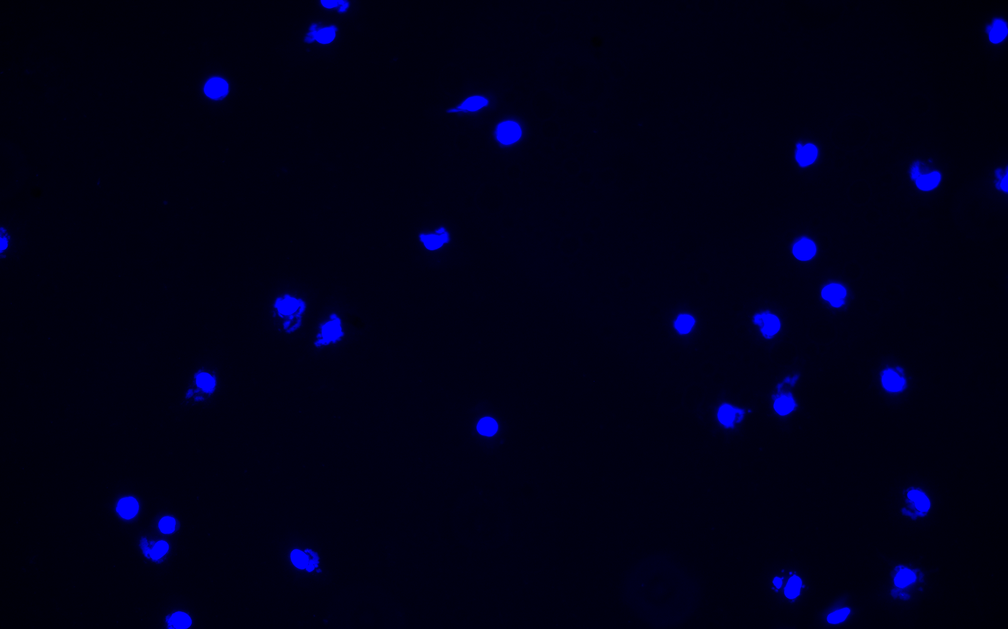
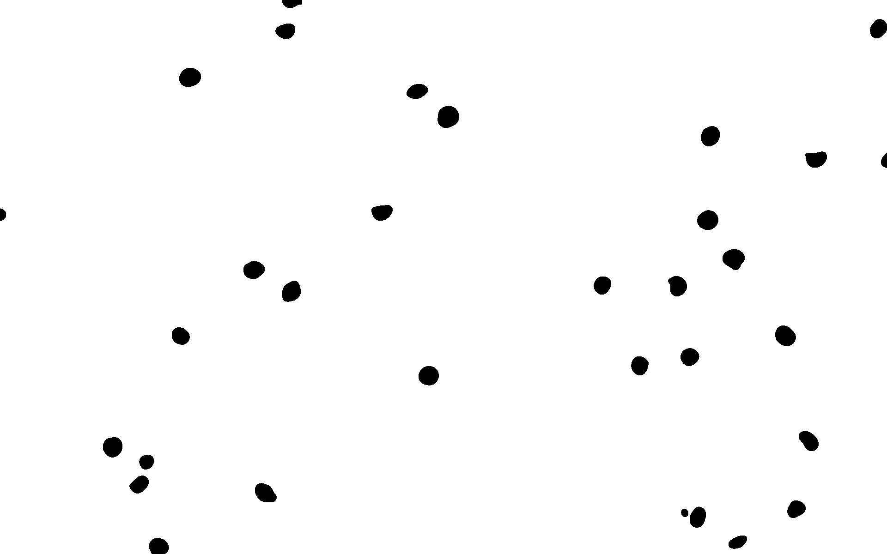
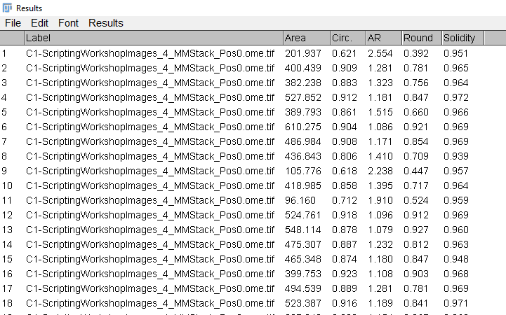
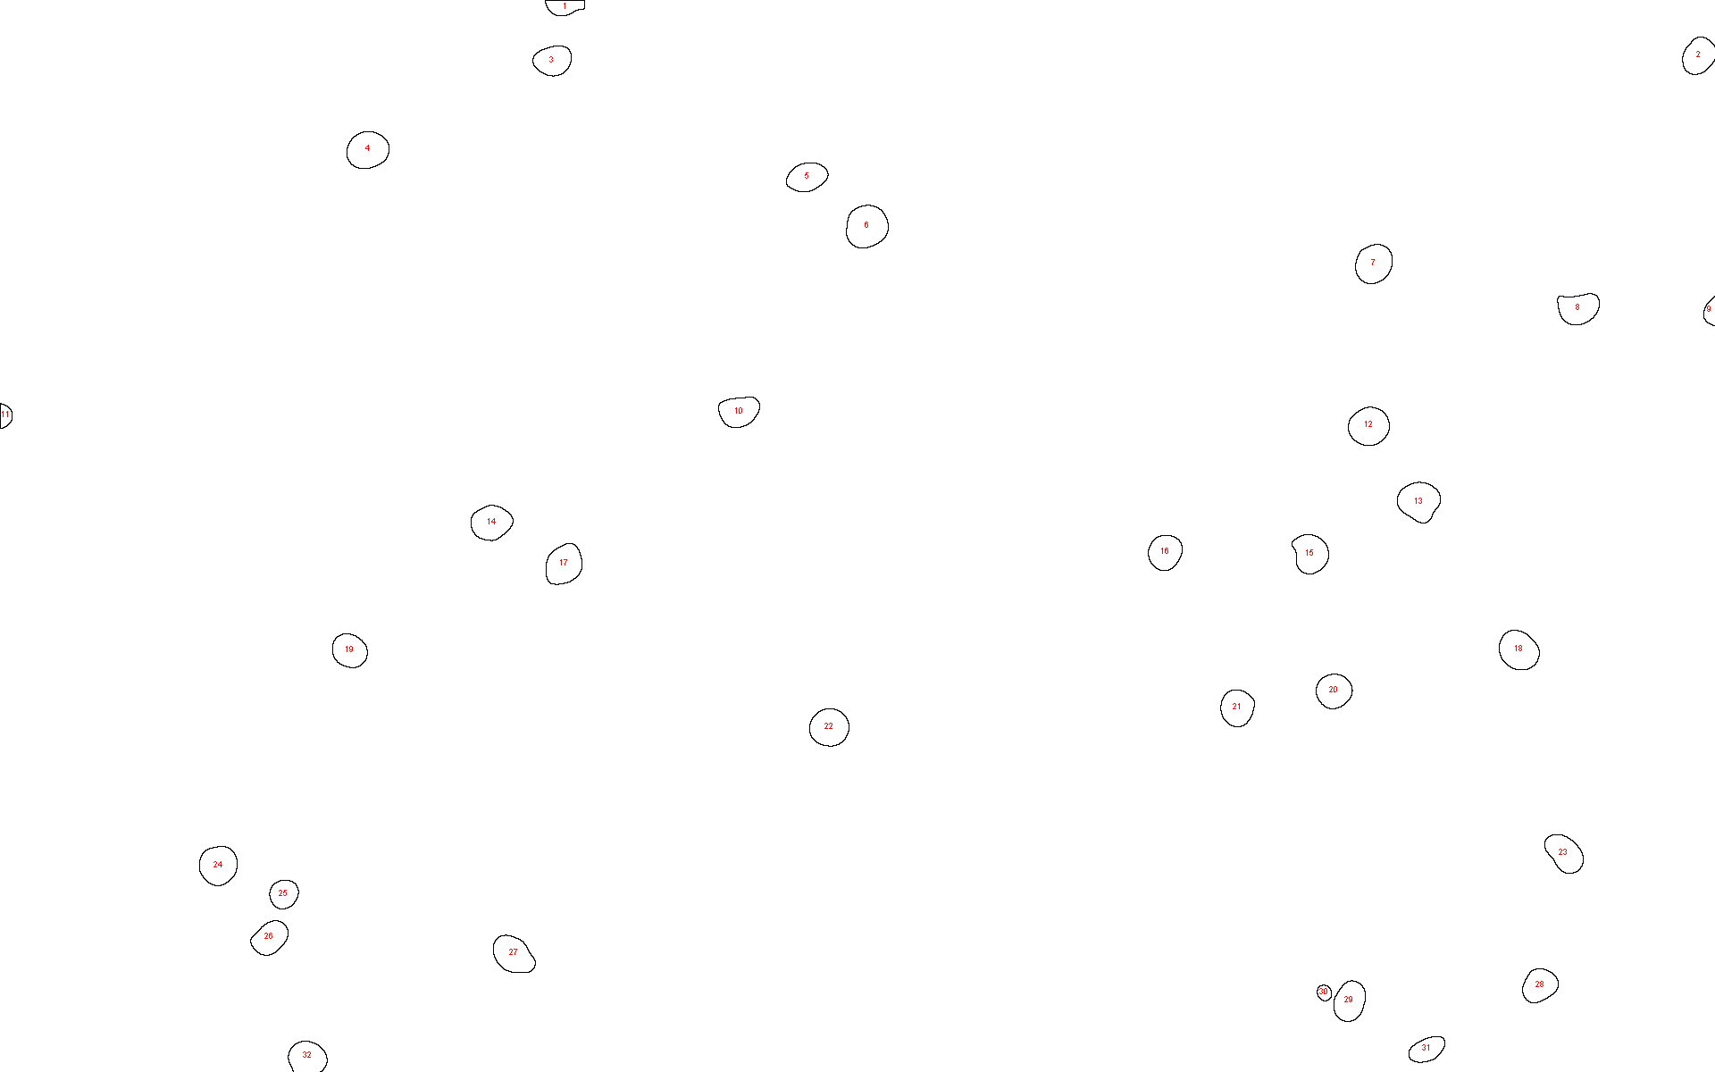
Challenge 2
Count the number of nuclei in each image

Slide 48
12 – Writing your own functions

Slide 49
What is a function?
Can be thought of as a self-contained script
A function is a block of code that can be passed variables and/or return a value
function myFunction(arg1, arg2, arg3) {
Add arg1 and arg2 together;
Divide result by arg3;
Print status;
return result;
}
Function name
Function parameters
function sum(a, b) {
return a + b;
}
s = sum(1, 2);
print(s); // output is 3
a and b are assigned the values 1 and 2

Slide 50
Functions don’t have to take arguments or return anything
function hello() {
print("Hello");
}
hello(); // prints “Hello” to the log window
Other names include…
methods (Java)
subroutines (older, low-level assembly languages)

Slide 51
DEMO 12 – Functions
Open Snippets/12_Functions.ijm
width

Slide 52
13 – requesting user input

Slide 53
DEMO 13 – Creating Dialogs
Open Snippets/13_Creating_Dialogs.ijm
width

Slide 54
Challenge 3
Modify your code for Challenge 2 to make use of a user interface (dialog) to request input parameters.

Slide 55
And Finally…

Slide 56
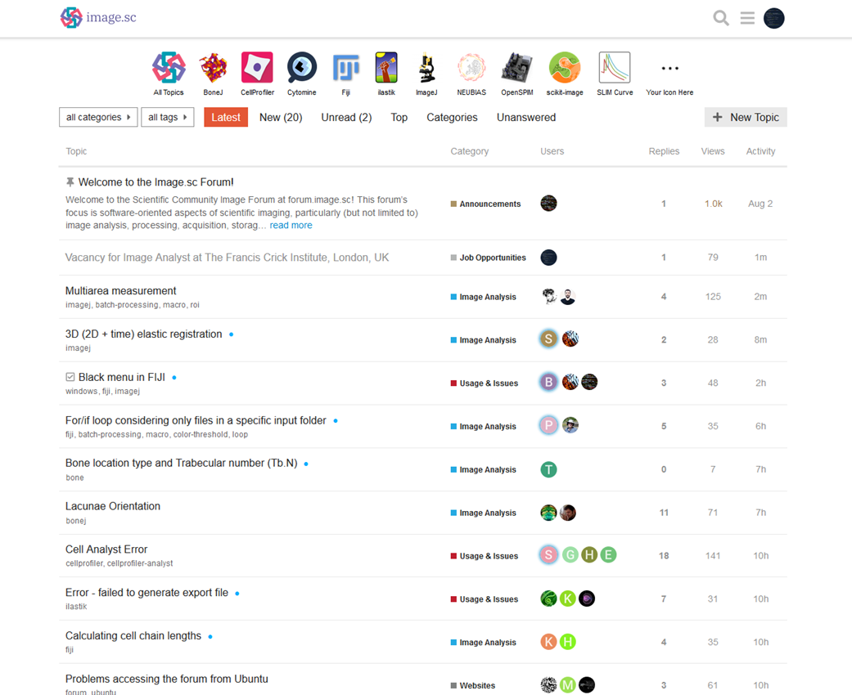

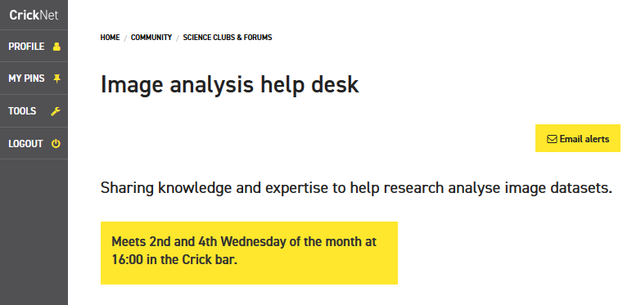


Thanks for sticking around
david.barry@crick.ac.uk
SW302

Slide 57
Useful references
https://doi.org/10.1371/journal.pcbi.1007433
https://doi.org/10.1371/journal.pcbi.1005871

